Slide 1
Monthly Matter – July/August 2024

Slide 2
In June, we asked you about online safety.
Here’s what you told us:

Slide 3
In June almost 2000 of you told us about online safety
76% of you felt safe and happy using online apps
Roblox was the app that most of you said made you feel unsafe or worried
27% of you said you talk a lot with your parents/carers about what you do online. But 26% of you said you don't talk a lot to your family about this
Some of you said you've reported something to an online app. But only 32% of you thought the app had taken your concerns seriously.

Slide 4
July and August’s Monthly Matter is about how you'll spend your time over the summer holidays Remember - You all have a right to relax and play.

Slide 5
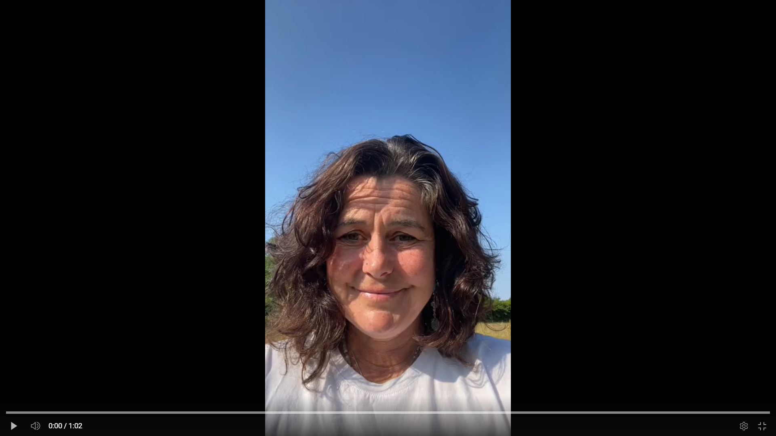
🎥 This month’s matter
Notes:
Linc i’r fideo – https://youtu.be/A-NfxON4PmE

Slide 6
1) Discuss in pairs or as a group:
What do you like to do in your local area when you’re not in school over the summer holidays?
Do you think there's enough to do in your area?
Is there anything that stops you from being able to do the things you enjoy?

Slide 7
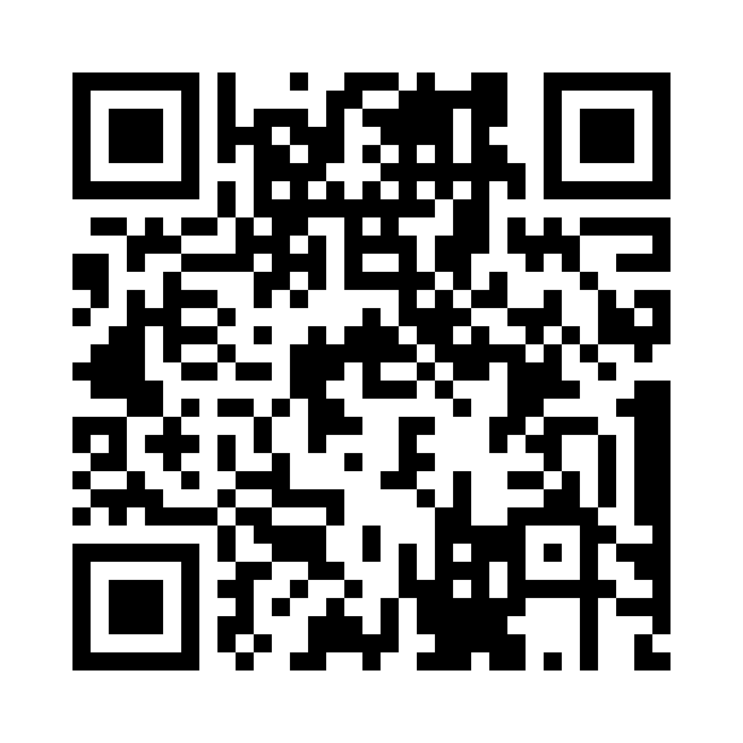
2) Share your ideas with us by using the QR code or survey link
(Each young person can do this individually or a teacher can do it on behalf of the class)
https://online1.snapsurveys.com/tb5sdf
Notes:
Survey link - https://online1.snapsurveys.com/tb5sdf

Slide 8
At the end of the survey, there’s an option for you to tell us what you think about Monthly Matters and how we can make it better.

Slide 9
Diolch! Thanks!
Our next Monthly Matter will be available on our website on Monday, September 2nd

