Slide 1
Monthly Matter – September 2024

Slide 2
In July/August, we asked you how you spent your time over the summer holidays.
Here’s what you told us:

Slide 3
In July/August over 1200 of you took part in our survey
The things you liked doing the most were spending time with family, being outside with friends, and doing sports and swimming
The weather, things being expensive, and not being allowed by parents were some of the things that stopped you from being able to do things you enjoy
63% of you thought there was enough to do in your local area
You wanted more play areas, more sports facilities, and swimming pools.

Slide 4
September’s Monthly Matter is about how shops sell some foods and energy drinks. Remember - You all have the right to be as healthy as possible.

Slide 5
🎥 Monthly Matters
Notes:
Link to the video – https://youtu.be/narNccv_ovc

Slide 6
Discuss in pairs or as a group:
Do you think where sugary, salty, or fatty food is displayed in a shop makes a difference to whether you buy them or not?
2. Do deals like buy one get one free make you want to buy foods like sweets, chocolates, and crisps?
3. The Welsh Government wants to stop restaurants and cafes from giving free refills of sugar-sweetened (fizzy) drinks. What do you think about this?
Notes:
Note for teachers - The Welsh Government want shops to stop putting foods like sweets, chocolates and crisps in certain places where lots of people will see them, like by the front door of the shop and by the till/checkout.

Slide 7
Watch this video and then discuss the 2 questions on the next slide
Notes:
Link to video: Proposal to end the sale of energy drinks to children under 16 (youtube.com)

Slide 8
Discuss in pairs or as a group:
4. Do children or young people your age drink energy drinks, like prime energy, monster, or red bull?
5. Do you think energy drinks should be sold to children under 16?

Slide 9
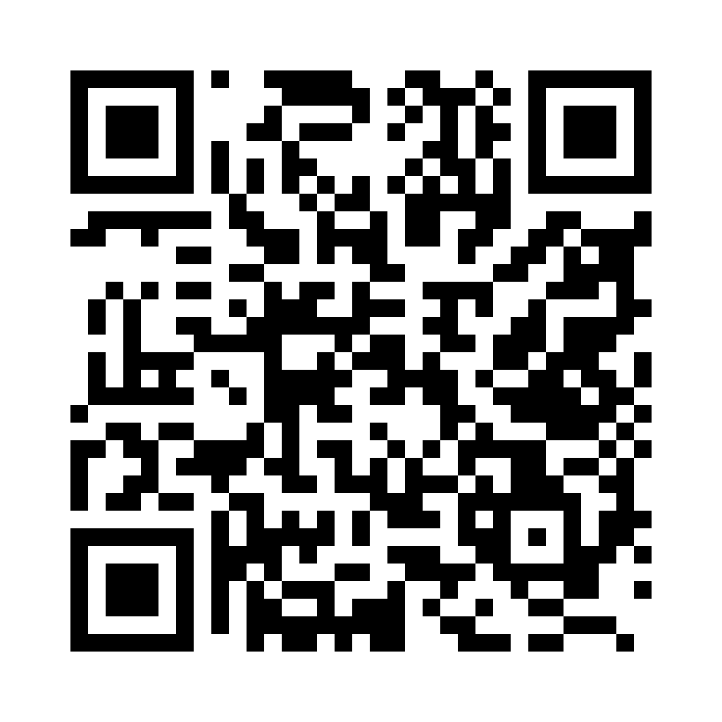
Share your ideas with us by using the QR code or survey link
(Each young person can do this individually or a teacher can do it on behalf of the class)
https://online1.snapsurveys.com/2o1zl
Notes:
Survey link - https://online1.snapsurveys.com/2o1zl

Slide 10
At the end of the survey, there’s an option for you to tell us what you think about Monthly Matters and how we can make it better.

Slide 11
Diolch! Thanks!
Our next Monthly Matter will be available on our website on Monday, October 7th

