Slide 1
Monthly Matter – November 2024

Slide 2
Last month, we asked you about smartphone use in schools.
Here’s what you told us:

Slide 3
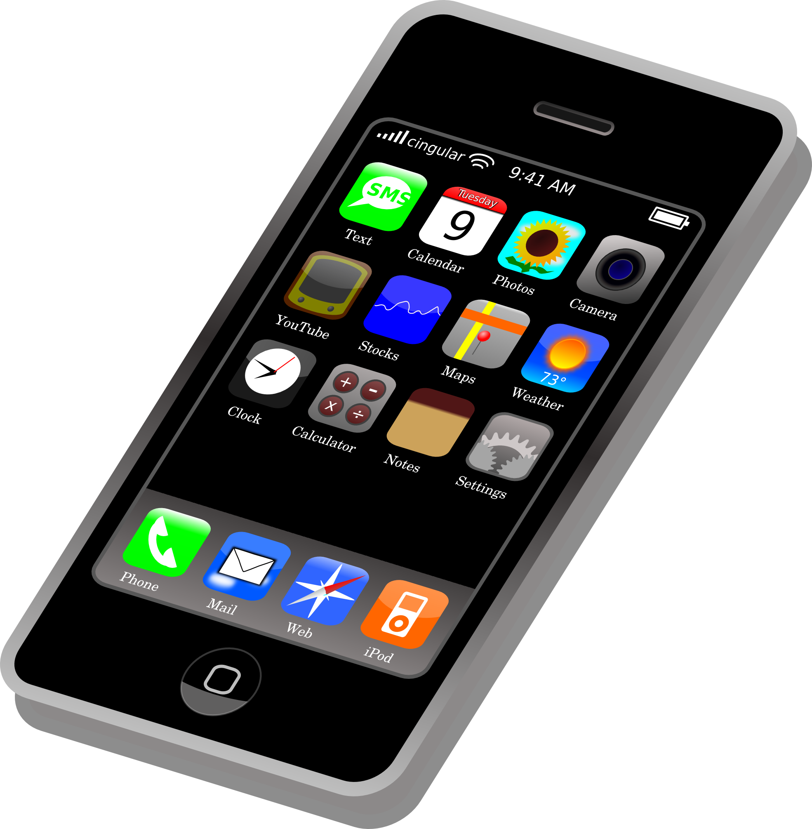
In October over 3000 of you told us about smartphone use in schools
Those of you in primary school who take a smartphone to school said you use it for messaging family and to help you feel safe
In secondary school, you said you use it for messaging family and friends, and for schoolwork/learning
91% of you are not allowed to use phones in class
51% of you said you didn't want more rules on phone use in schools

Slide 4
Novembers Monthly Matter is about the environment. Remember: Article 24 says that governments should make sure children have a clean environment so they can stay healthy.

Slide 5
🎥 This month’s matter: Environment
Notes:
Linc i’r fideo – https://youtu.be/fX4iD52NCKM

Slide 6
1) Discuss in pairs or as a group:
What are you already doing at home with your family/carers?
What are you already doing in your school or community group?
Is there anything else you would like to do?
Do you know what your local council or Welsh government are doing?
Do adults who support you have enough information to support this discussion?
Notes:
There are supporting materials on our web page for children with additional learning needs

Slide 7
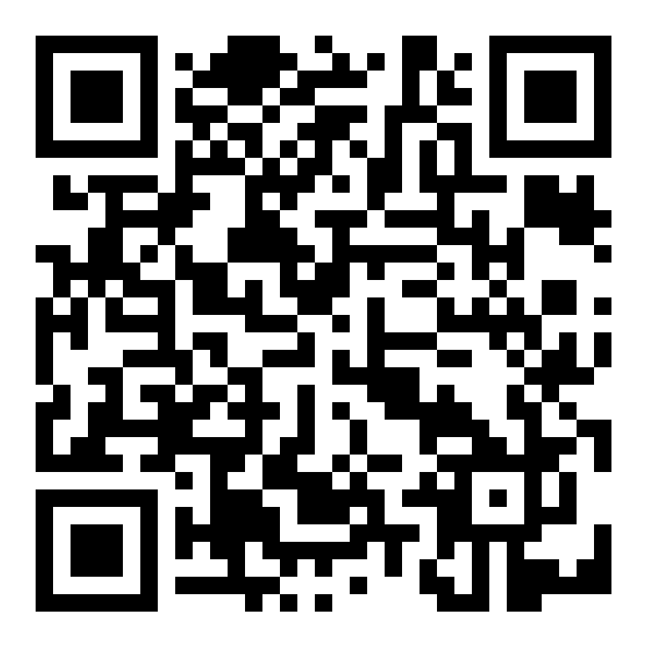
2) Share your ideas with us by using the QR code or survey link
(Each young person can do this individually or a teacher can do it on behalf of the class)
https://online1.snapsurveys.com/hv7xgu
Notes:
Survey link - https://online1.snapsurveys.com/hv7xgu

Slide 8
Diolch! Thanks!
Our next Monthly Matter will be available on our website on
Monday, December 2nd

