Slide 1
Mater y Mis – Rhagfyr 2024 Monthly Matter – December 2024

Slide 2
Mis diwethaf, fe wnaethom ni ofyn i chi eich barn am yr amgylchedd.
Dyma beth ddywedodd bron 1,000 ohonoch:
Last month, we asked you about the Environment. Here’s what almost 1,000 of you said:

Slide 3
Dim ond 20% ohonoch oedd yn gwybod beth mae Llywodraeth Cymru yn ei wneud i helpu’r amgylchedd
Only 20% of you knew what the Welsh Government are doing to help the environment
Roedd 46% ohonoch yn teimlo bod gennych chi ddigon o wybodaeth yn barod ar helpu'r amgylchedd
46% of you knew felt you had enough information already on helping the environment
Gartref, mae llawer ohonoch yn ailddefnyddio bagiau siopa, yn diffodd goleuadau, ac yn defnyddio biniau gwastraff bwyd
At home, lots of you are re-using shopping bags, turning off lights, and using food waste bins
Notes:
Linc 1af - https://www.gweithreduarhinsawdd.llyw.cymru/
2il linc - https://sizeofwales.org.uk/cy/adnoddau-addysg/
1st link - https://www.climateaction.gov.wales/
2nd link - https://sizeofwales.org.uk/education-resources/

Slide 4
Mae Mater mis Rhagfyr yn ymwneud a Diwrnod Hawliau Dynol
December’s Monthly Matter is about Human Rights Day

Slide 5
🎥Fideo Cymraeg – Go to the next slide for the English video
Notes:
Linc i'r fideo - https://youtu.be/s9QKvUpUmLo

Slide 6
🎥English video
Notes:
Link to the video - https://youtu.be/18bR9a32CGE

Slide 7
Darllenwch y datganiadau ar y sleidiau nesaf.
Beth yw eich barn?
Sut ydy'r syniadau yma yn effeithio ar eich hawliau?
Mae rhai hawliau penodol ar y sleid i'ch helpu.
Read the statements on the next slides.
What's your opinion?
How do these ideas affect your rights?
There are specific rights on the slides to help you.

Slide 9
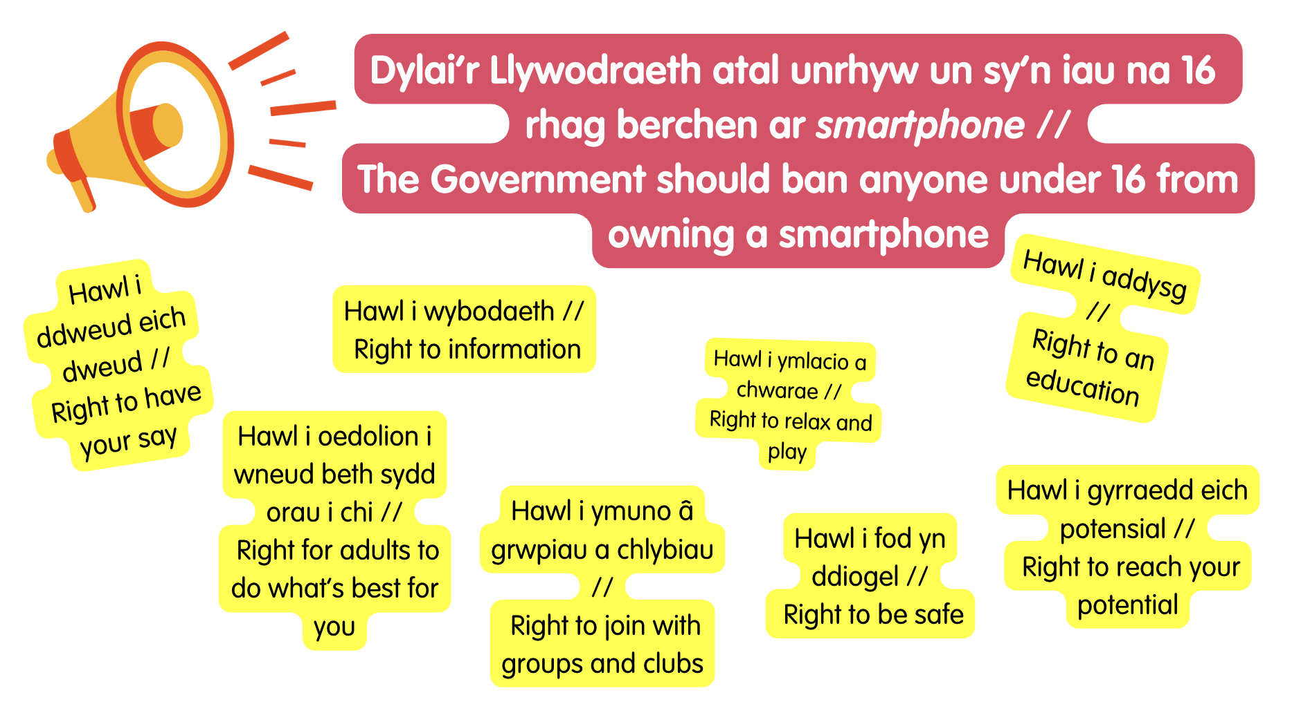

Slide 10
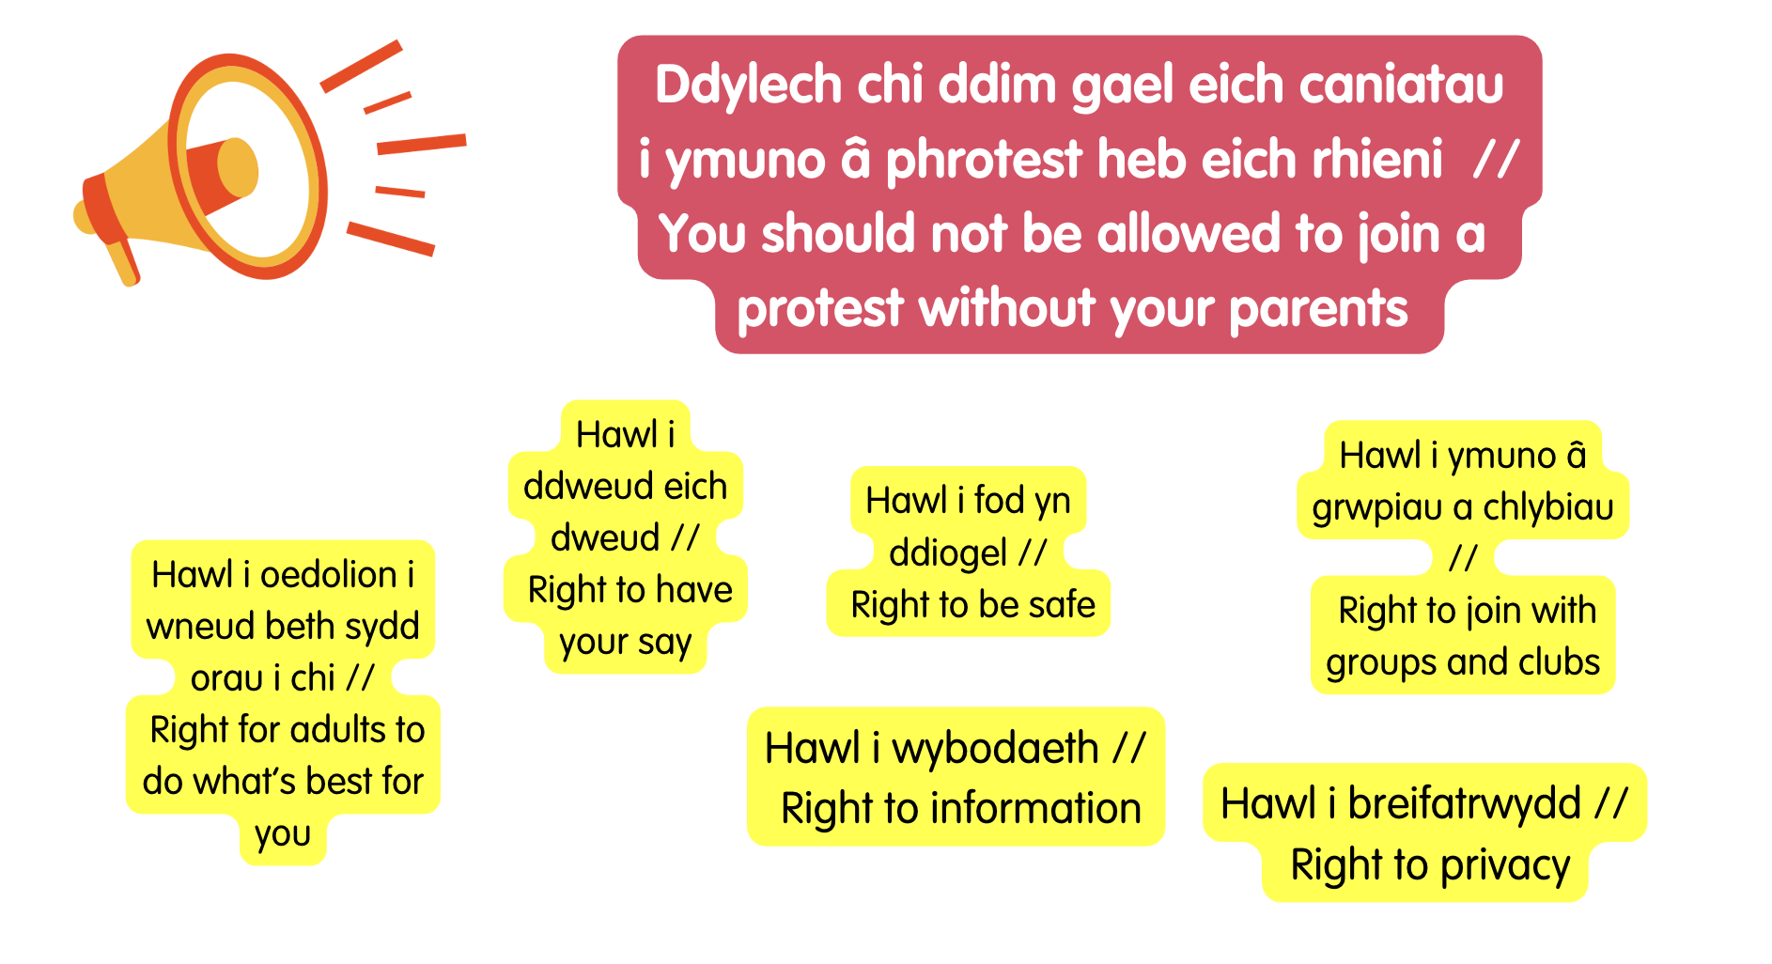

Slide 11
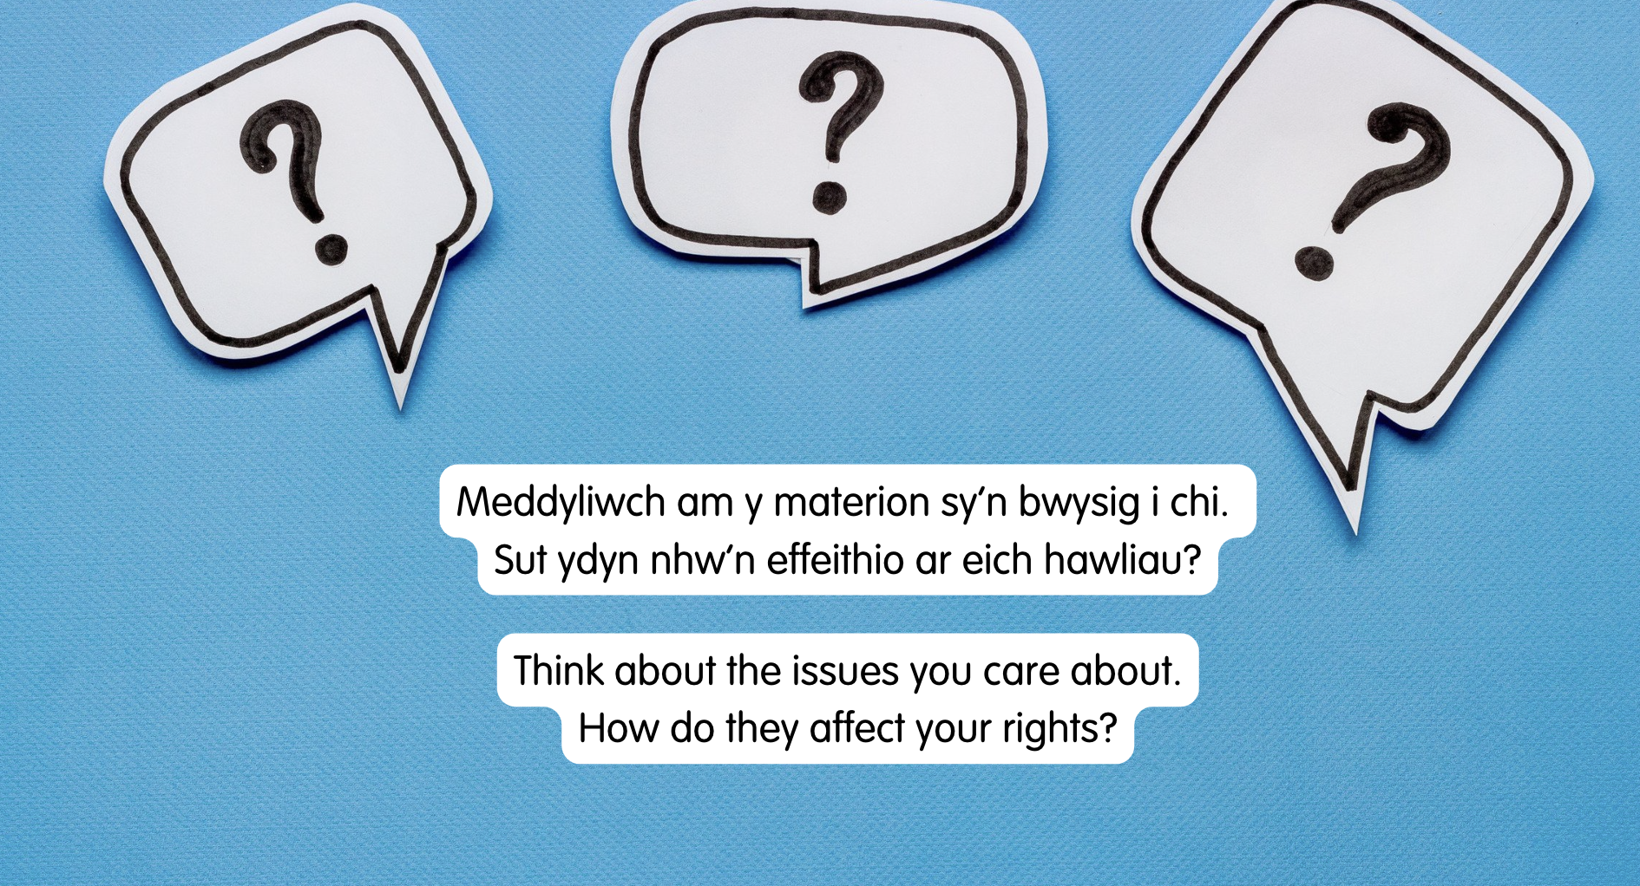
Notes:
There are supporting materials on our web page for children with additional learning needs

Slide 12
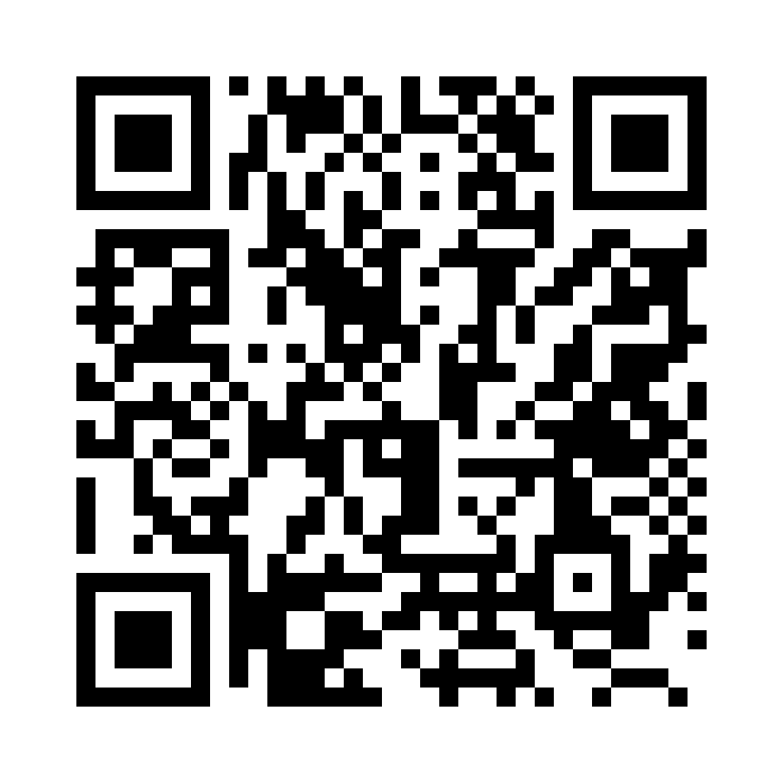
Rhannwch eich syniadau gyda ni wrth ddefnyddio cod QR yr holiadur neu’r ddolen
(Gall pob person ifanc wneud hyn yn unigol neu gall athro ei wneud ar ran y dosbarth)
Tell us how we can help you know more about your rights through this QR code or survey link
(Each young person can do this individually or a teacher can do it on behalf of the class)
https://online1.snapsurveys.com/p5es7e
Notes:
Survey link -

Slide 13
Athrawon – os rydych chi eisiau ni gysylltu gyda chi’n uniongyrchol gydag adnoddau hawliau a syniadau am weithgareddau, rhowch eich enw ar yr ebost gwag yma ac anfonwch nôl aton ni. Diolch!
Teachers – if you want us to get in touch with you directly with rights resources and ideas, add your name to this blank email and press send. Diolch!
Notes:
Linc i'r ebost: post@complantcymru.org.uk
Link to the email: post@childcomwales.org.uk

Slide 14
Diolch! Thanks!
Bydd Mater y Mis nesaf ar gael ar ein gwefan yn y flwyddyn newydd, Dydd Llun, y 6ed o Ionawr
Our next Monthly Matter will be available on our website in the New Year, Monday, 6 January

