Slide 1
Facilitator Notes:
This month we are talking about Article 27 "Governments should make sure families have access to good housing".
We know this is a sensitive topic and there may be some children and young people that will find this topic difficult.
You know your children and young people best so please choose an option that you think will work best for your group. This might mean leaving some questions out of group discussions or asking your group to fill in the survey independently and missing out the group discussion.
Remind children and young pepole of who they can go to for support and leave our Advice slide up at the end of the session.

Slide 2
Monthly Matter – January 2025

Slide 3
Last month, we asked you about how you would like to learn more about your rights.
Here’s what you told us:

Slide 4
In December you discussed Human Rights Day, and told us how you would like to learn more about children’s rights and which topics interested you
Health was the topic that interested you the most
This was closely followed by safety, having your voice heard, and education
Watching videos was how most of you wanted to learn more about your rights

Slide 5
January’s Monthly Matter is about children and young people's homes. Remember: Article 27 says Governments should make sure families have access to good housing.

Slide 6
Notes:
Link to the video: https://youtu.be/_I44RAUEruE

Slide 7
1) Discuss in pairs or as a group:
What sort of home do you live in?
What do you like about your home and what would you change?
What makes a good home?
Notes:
There are supporting materials on our web page for children with additional learning needs

Slide 8
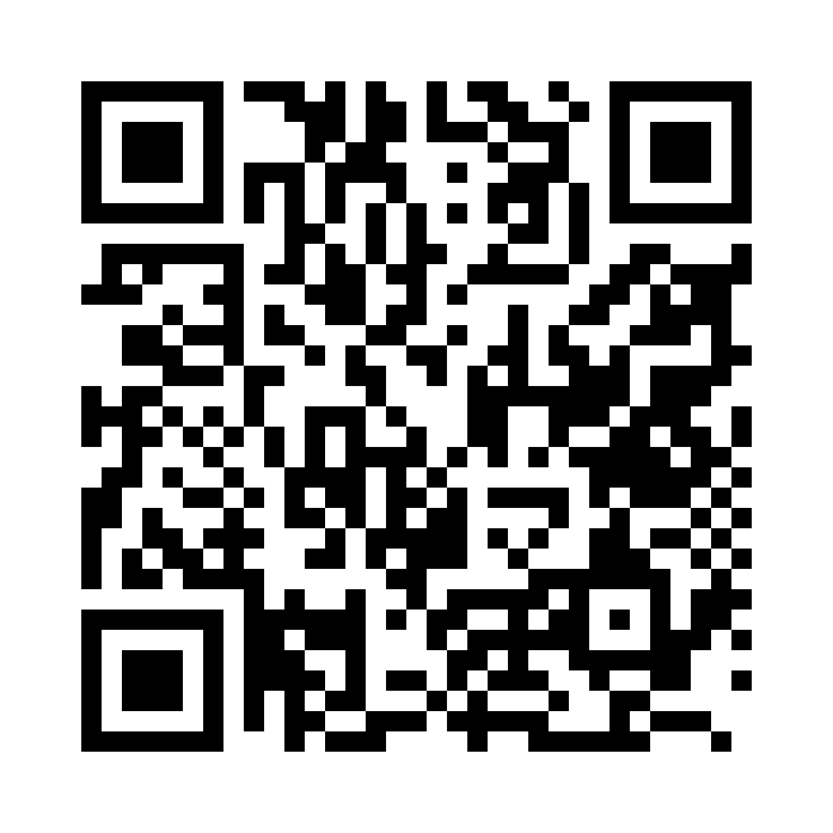
2) Share your ideas with us by using the QR code or survey link
(Each young person can do this individually or a teacher can do it on behalf of the class)
https://online1.snapsurveys.com/kmz0y2
Notes:
Survey link - https://online1.snapsurveys.com/kmz0y2

Slide 9
If you are worried after todays session.
You should speak to a trusted adult
You could also contact our Advice team:
0808 801 1000
advice@childcomwales.org.uk
www.childcomwales.org.uk
Notes:
You could also contact & speak to –
Childline – 0800 1111
Meic – 080880 23456

Slide 10
Diolch! Thanks!
Our next Monthly Matter will be available on our website on
Monday, February 3rd

