Slide 1
Monthly Matter – February 2025

Slide 2
Last month, over 1,000 of you told us what your home means to you.
Here’s a taste of what we heard:

Slide 3
Here are some of the top answers about what you loved about your home: comfort and cosiness, your bed or bedroom, your family, and feeling safe
When it comes to doing schoolwork at home, you valued privacy, a quiet space, and a desk
We asked you, 'what makes a good home?' You said family, safety, and comfort

Slide 4
February’s Monthly Matter is asking you if you know what is real and what is fake online? Remember: Article 17 says you have the right to get information in lots of ways, as long as it’s safe.

Slide 5
Notes:
Link to the video: https://youtu.be/KjyCZ8xdoQo

Slide 6
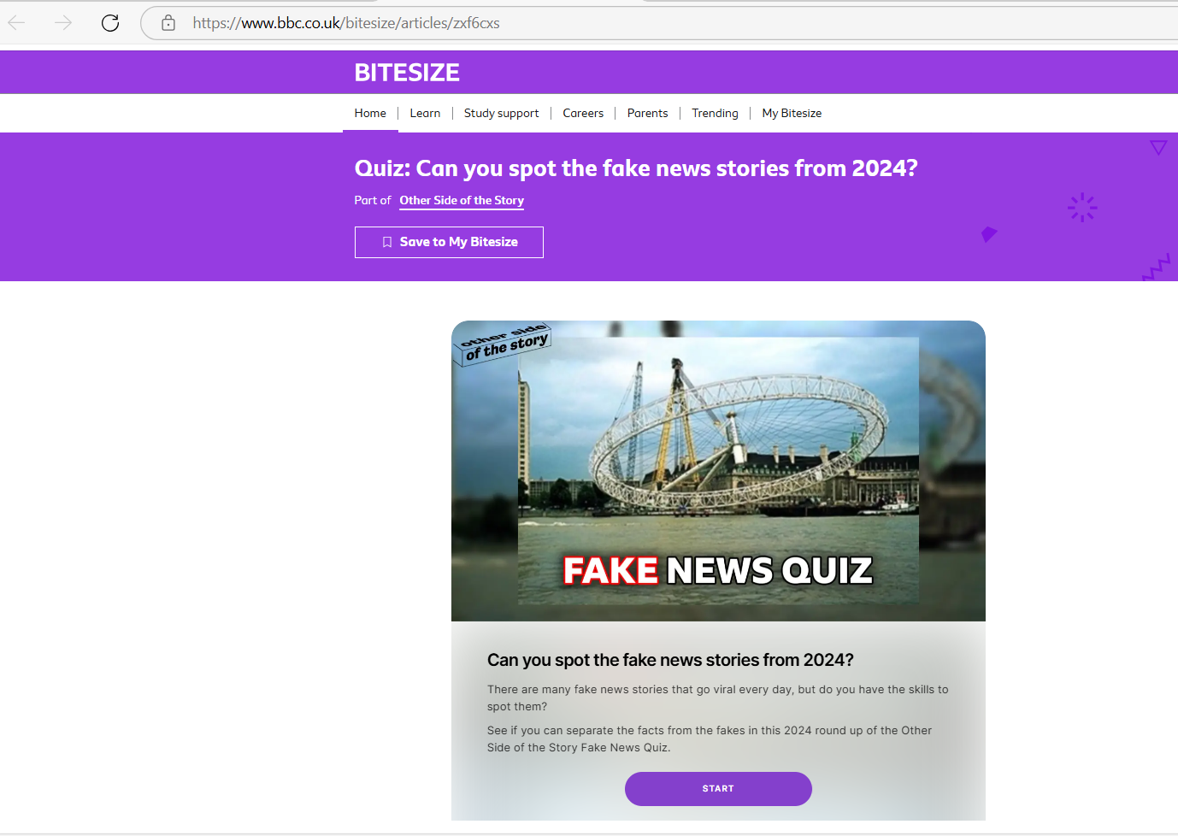
You can complete the whole BBC Bitesize 'Fake News Quiz' quiz here:
Quiz: Can you spot the fake news stories from 2024? - BBC Bitesize
Notes:
Link to quiz: https://www.bbc.co.uk/bitesize/articles/zxf6cxs

Slide 7
1) Discuss in pairs or as a group:
How do you know what’s real and what’s not online?
Have you ever believed something you saw online that turned out to be fake?
How can you check if something is real or not?
Notes:
There are supporting materials on our web page for children with additional learning needs

Slide 8
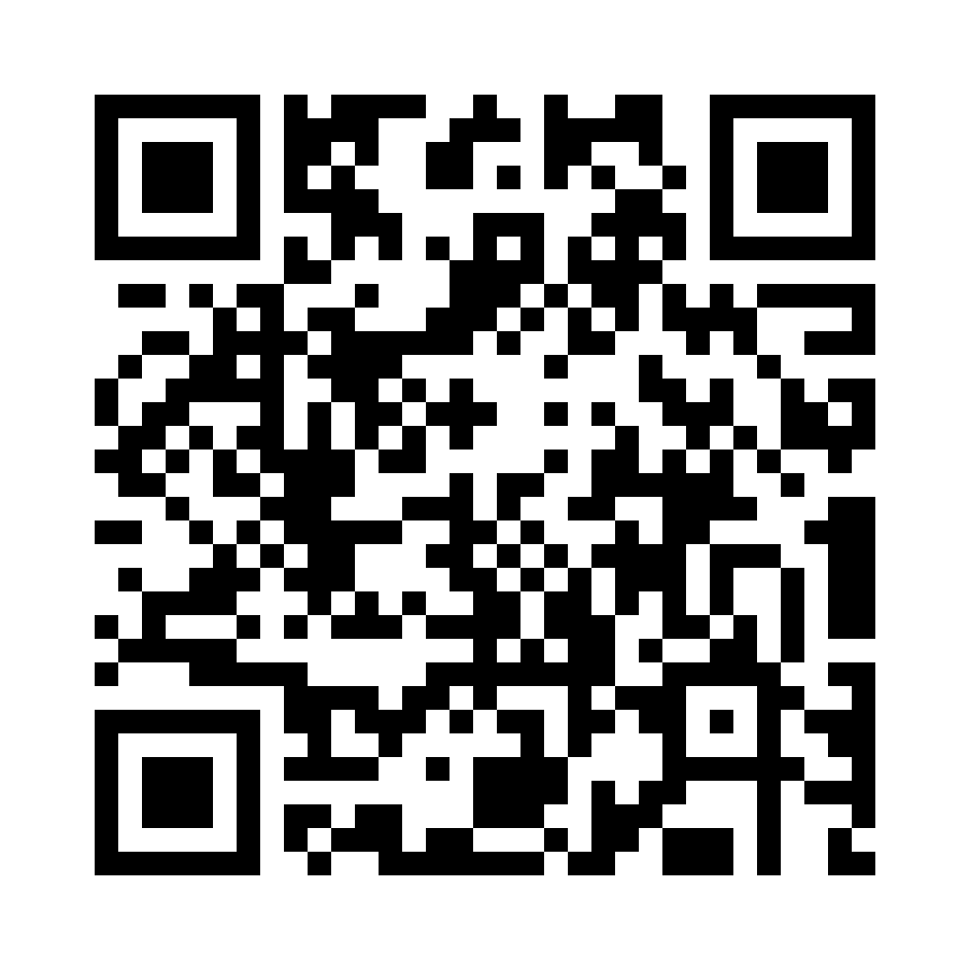
2) Share your ideas with us by using the QR code or survey link
(Each young person can do this individually or a teacher can do it on behalf of the class)
https://online1.snapsurveys.com/90oau
Notes:
Survey link - https://online1.snapsurveys.com/90oau

Slide 9
Useful Links
These websites can help you to spot the facts from the fibs!
https://fullfact.org/
https://www.snopes.com/
https://www.bbc.co.uk/news/bbcverify
https://www.channel4.com/news/factcheck

Slide 10
Safer Internet Day
If you want to explore this issue further in your school, this month's Safer Internet Day topic is 'Too good to be true? Protecting yourself and others from scams online'
There are free resources available for a range of ages

Slide 11
If you are worried about anything after today's session you should speak to a trusted adult.
You could also contact our Advice team:
0808 801 1000
advice@childcomwales.org.uk
www.childcomwales.org.uk
Notes:
You could also contact & speak to:
Childline – 0800 1111
Meic – 080880 23456

Slide 12
Diolch! Thanks!
Our next Monthly Matter will be available on our website on
Monday, March 3rd

