Slide 1
Monthly Matter – March 2025

Slide 2
Last month, we asked you if you knew what was real and what was fake online.
And here’s what you told us:

Slide 3
Only 13% of you said you'd report something online that seemed fake
74% of you said it's easy to believe something fake online
72% of you said you are more likely to believe things that come from well-trusted sources
61% of you said social media companies or websites could add warnings or fact-checking labels to posts to help stop the spread of fake information

Slide 4
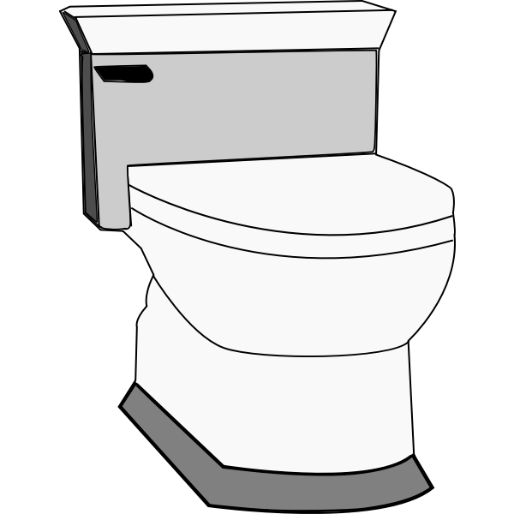
March’s Monthly Matter is about school toilets. We often hear children and young people’s concerns about school toilets. Remember: Article 19 – Right to feel safe Article 24 – Right to be healthy

Slide 5
Notes:
Link to the video: https://youtu.be/IAC56Mx9kI8

Slide 6
1) Discuss in pairs or as a group:
What are the rules in your school?
How do you feel about using the toilets in your school?
How would you describe your school toilets?
Notes:
There are supporting materials on our web page for children with additional learning needs

Slide 7
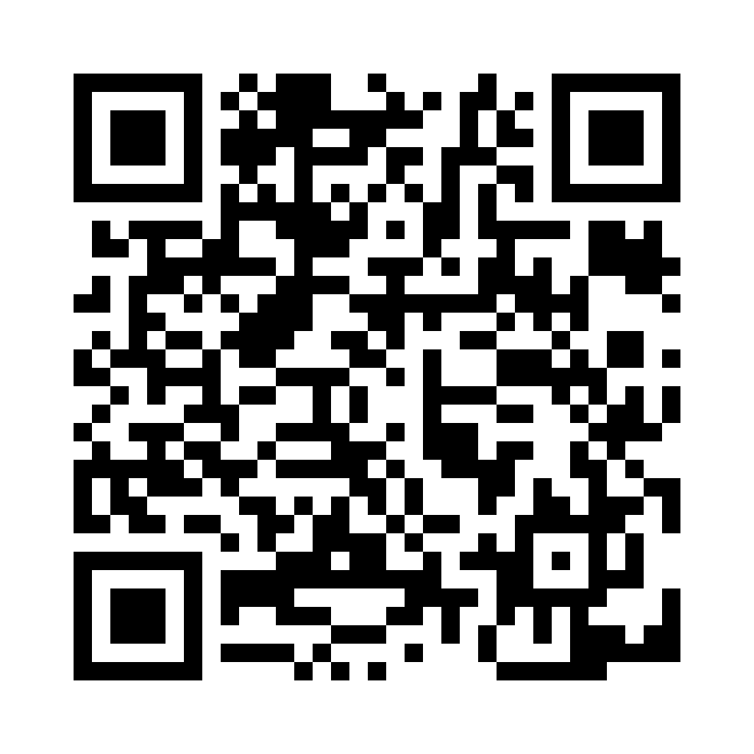
2) Share your ideas with us by using the QR code or survey link
(Each young person can do this individually or a teacher can do it on behalf of the class)
https://online1.snapsurveys.com/noclov
Notes:
Survey link - https://online1.snapsurveys.com/noclov

Slide 8
If you are worried about anything after today's session you should speak to a trusted adult.
You could also contact our Advice team:
0808 801 1000
advice@childcomwales.org.uk
www.childcomwales.org.uk
Notes:
You could also contact & speak to:
Childline – 0800 1111
Meic – 080880 23456

Slide 9
Diolch! Thanks!
Our next Monthly Matter will be available on our website on
Monday, March 31st

