Slide 1
Monthly Matter – April 2025

Slide 2
Last month, we asked you how you felt about school toilets.
And here’s what you told us:

Slide 3
56% of you were not happy with your school toilets
62% of you can go to the toilet in lesson time
When it comes to toilet paper, 21% of you said toilet paper was either not available or hardly ever available
57% of you thought the toilets were clean or not too bad

Slide 4
It's clear that school toilets are a problem for some children and young people across Wales.
We'll be sharing your responses with the Welsh Government, local councils, and other people who could help change things.

Slide 5
April’s Monthly Matter is about World Health Day and we'd like to know more about how you look after your teeth. Remember: Article 24 – Right to be healthy

Slide 6
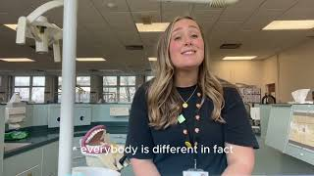
Notes:
Link to the video: https://youtu.be/gN8mdqtzcaQ

Slide 7
Discuss in pairs or as a group:
Since the start of the school year, have you seen a dentist?
What foods and drinks should we be more careful with when it comes to teeth?
When should you brush? How long for? How often? Do you rinse after you brush or not?
Notes:
There are supporting materials on our web page for children with additional learning needs

Slide 8
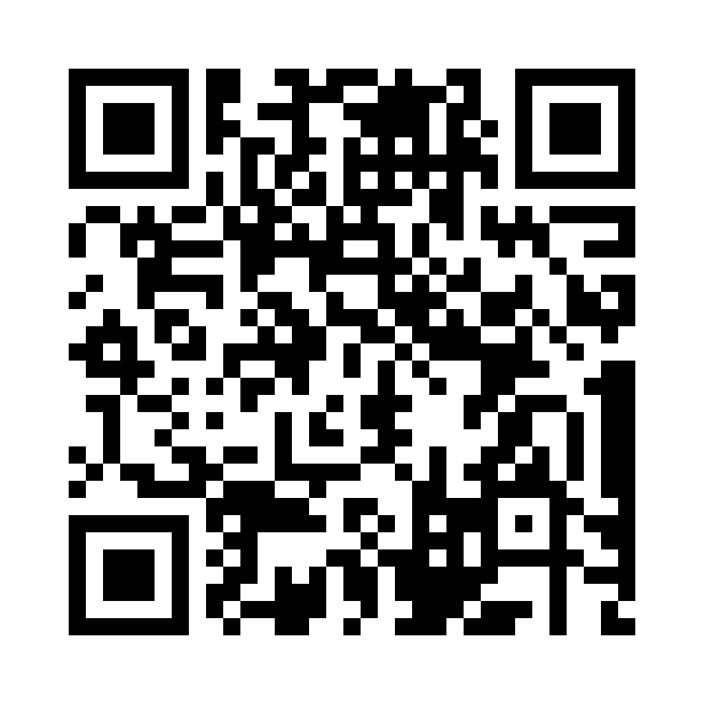
Share your ideas with us by using the QR code or survey link
(Each young person can do this individually or a teacher can do it on behalf of the class)
Notes:
Survey link -

Slide 9
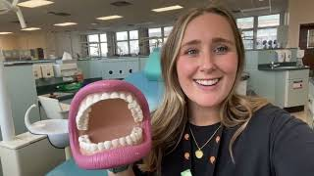
Top Tips – How you can look after your teeth
Notes:
Link to video: https://www.youtube.com/watch?v=KIlWUJ0y3x4

Slide 10
And a couple more!
Brush your teeth twice a day – one of these should be just before you go to bed
Brush for two minutes

Slide 11
If you are worried about anything after today's session you should speak to a trusted adult.
You could also contact our Advice team:
0808 801 1000
advice@childcomwales.org.uk
www.childcomwales.org.uk
Notes:
You could also contact & speak to:
Childline – 0800 1111
Meic – 080880 23456

Slide 12
Useful links
Information for parents and carers
Information for schools and nurseries
Foundation phase resources
KS2 resources

Slide 13
Diolch! Thanks!
Our next Monthly Matter will be available on our website on
Tuesday 6 May

